Slide 1
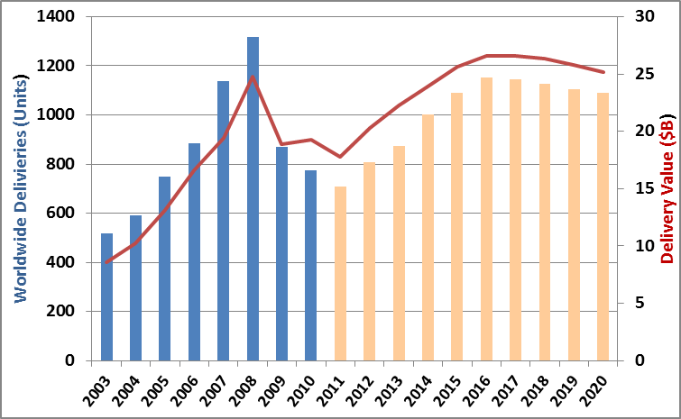
Delivery Trough In 2011; Values Forecast to Exceed 2008 Levels But Not Units; Dip In 2017
Observations
Worldwide Bizjet Delivery Forecast
2008 peak to 2011 trough -46% compares with -34% during last 2003 downturn
2008 levels not reached again in forecast period
Stricter finance requirements
Fractional becomes a replacement, not growth market
“Perfect storm” of each market driver unlikely in forecast period
However 2008 delivery values are surpassed in 2015 due to larger aircraft
Cyclical downturn begins in 2017
2011-2020
10,102 Jets
Worth $240B
Source: BRiFO Forecast

Slide 2
Outlook: Not Always First In, First Out
FBO
Charter
/Frax
MRO
?
Piston
?
Turboprop
Big Cabin Jet
Small/Mid Jet
?
?
Heli
2007
2008
2009
2010
2011
2012
Downturn Began
Recovery Begins
Notes:
GA more than just bizjets
You know how helicopters fly? They’re so ugly the Earth repels them.

